Slide 1

PREDICTIVE MODEL ANALYSIS
For purpose of Forage Internship

Slide 2
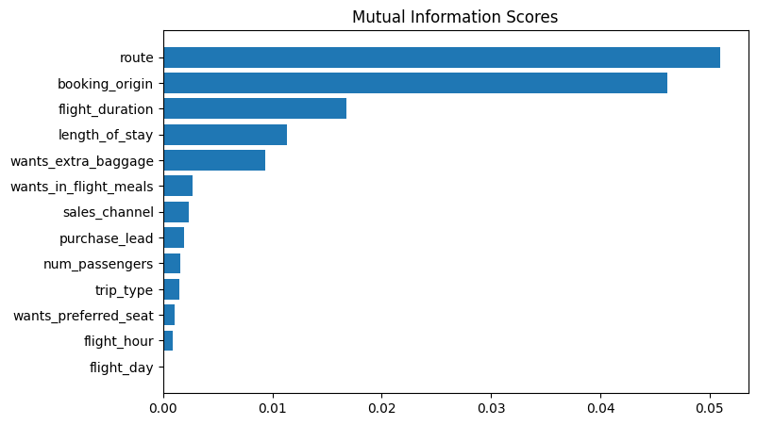
PREDICTIVE MODEL TO UNDERSTAND FACTORS THAT INFLUENCE BUYING BEHAVIOUR
For purpose of Forage Internship
Mutual Information Plot
The top 5 features which are depended on booking complete feature
1. Route
2. Booking origin
3. Flight duration
4. Wants extra baggage
5. Length of stay
We have trained the data set with Random forest classifier model and received
ACCURACY: 85.37
AUC score: 0.57

